Slide 1
Activity 2:
Uncovering Stories from Data
Members: Euie, James, JB, John, Matt

Slide 2
Contents & Sequence:
Urban vs. Rural Differences (by James)
Impact of Education on Income (by Euie)
Household Size and Spending (by John)
Gender Differences in Household Economics (by Matt)
Regional Spending Patterns (by JB)
Personal Exploration: “Impact of Lifestyle on Household Cost of Living”
Special Occasions Expenditure (by JB)
Number of Car, Jeep, Van (by Matt)
Tenure Status (by John)
Clothing, Footwear and Other Wear Expenditure (by James)
Tobacco + Alcoholic Beverages Expenditure (by Euie)

Slide 3
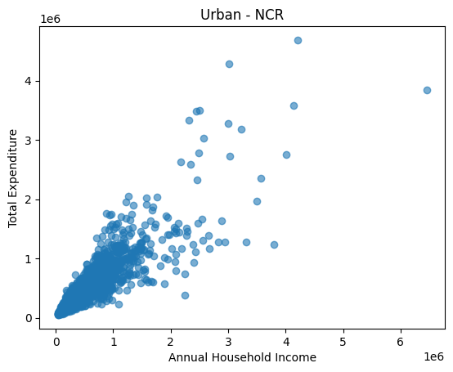
1. Urban vs. Rural Differences (NCR vs. VIII Eastern Visayas)
Income Bracket |  | Annual Household Income | Total Expenditure
0 | Poor | 102868.52 | 132141.08
1 | Low Income | 198776.17 | 226004.41
2 | Lower Middle | 371226.56 | 372991.53
3 | Middle Income | 685871.06 | 637947.56
4 | Upper Middle | 1141796.34 | 969129.13
5 | Upper Middle not Rich | 2024821.18 | 1506951.32
6 | Rich | 3485836.88 | 2466226.76
The scatter plot shows a strong positive correlation between income and expenditure: as household income rises, total expenditure also rises.
However, the slope is relatively steep at lower brackets (poor households overspend relative to income), then flattens at higher brackets (rich households save more, so expenditure grows slower than income).
Urban = NCR (Annual Average)

Slide 4
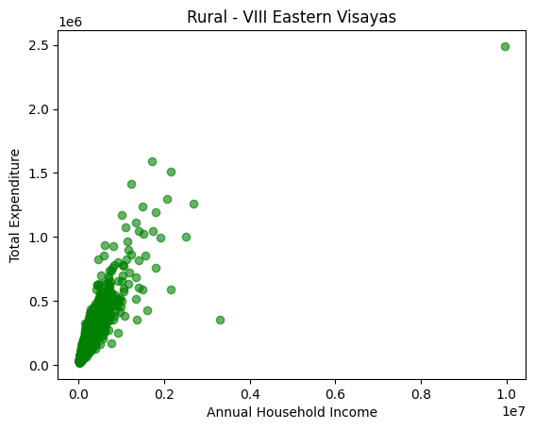
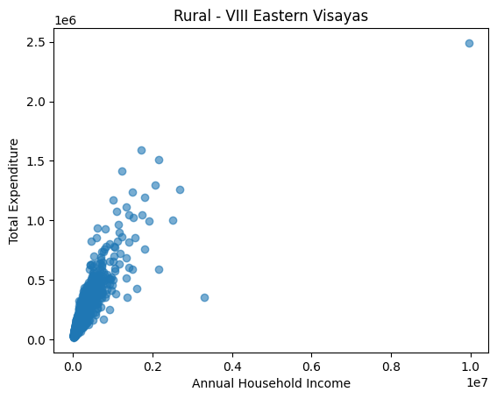
1. Urban vs. Rural Differences (NCR vs. VIII Eastern Visayas)
Income Bracket |  | Annual Household Income | Total Expenditure
0 | Poor | 86842.84 | 94300.07
1 | Low Income | 179450.44 | 169383.27
2 | Lower Middle | 364196.00 | 313352.36
3 | Middle Income | 674303.56 | 474309.18
4 | Upper Middle | 1177287.24 | 740481.74
5 | Upper Middle not Rich | 1944425.60 | 1042423.90
6 | Rich | 5313682.67 | 1367594.00
The scatter plot also shows a positive correlation: higher income households spend more.
But the slope is flatter overall compared to NCR — expenditure grows more slowly relative to income.
Poor households spend less than income, and rich households spend far less relative to income, so the points cluster below the “income = expenditure” line.
Rural = VIII Eastern Visayas (Annual Average)

Slide 5
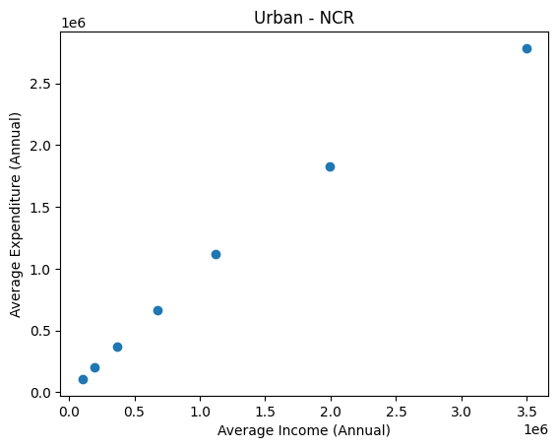
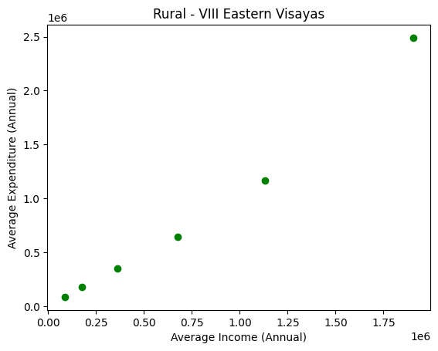
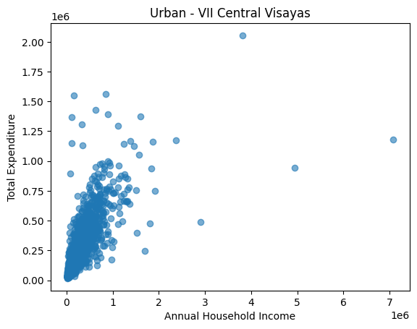
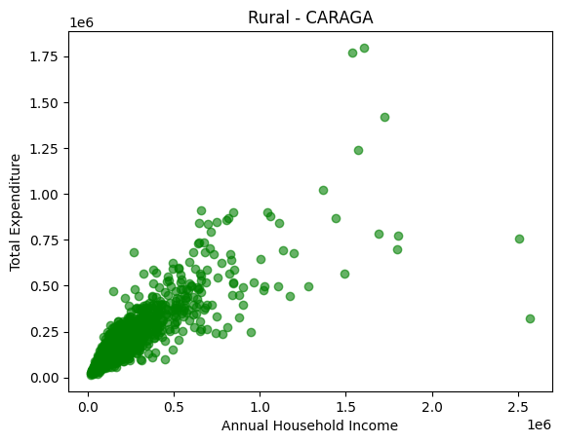
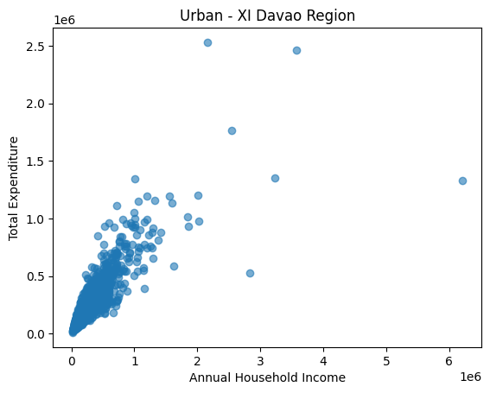
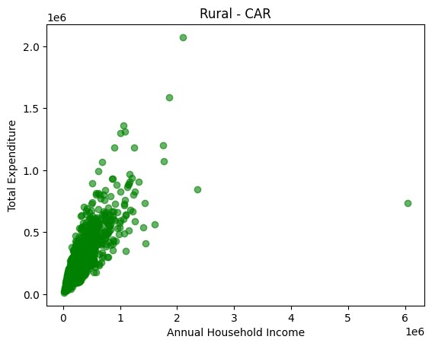
1. Urban vs. Rural Differences (NCR vs. VIII Eastern Visayas)
Income Bracket |  | Annual Household Income | Total Expenditure
0 | Poor | 102868.52 | 132141.08
1 | Low Income | 198776.17 | 226004.41
2 | Lower Middle | 371226.56 | 372991.53
3 | Middle Income | 685871.06 | 637947.56
4 | Upper Middle | 1141796.34 | 969129.13
5 | Upper Middle not Rich | 2024821.18 | 1506951.32
6 | Rich | 3485836.88 | 2466226.76
Income Bracket |  | Annual Household Income | Total Expenditure
0 | Poor | 86842.84 | 94300.07
1 | Low Income | 179450.44 | 169383.27
2 | Lower Middle | 364196.00 | 313352.36
3 | Middle Income | 674303.56 | 474309.18
4 | Upper Middle | 1177287.24 | 740481.74
5 | Upper Middle not Rich | 1944425.60 | 1042423.90
6 | Rich | 5313682.67 | 1367594.00

Slide 6
1. Urban vs. Rural Differences (NCR vs. VIII Eastern Visayas)
NCR: Low-income households overspend relative to income; middle brackets balance; rich households save but still spend heavily in absolute terms. Stronger, steeper positive correlation — income and expenditure rise together, especially at lower brackets. Consumption-driven behavior.
VIII Eastern Visayas: Low-income households spend less than income; middle and upper brackets consistently spend below income; rich households spend far less relative to income. Positive but flatter correlation — households spend less relative to income, especially at higher brackets. Savings-driven behavior.
Insight: NCR shows a consumption‑driven pattern, while Eastern Visayas reflects restrained spending and higher savings margins. Both regions show positive correlation between income and expenditure, but urban households exhibit a stronger consumption link, while rural households show a weaker, more restrained correlation.

Slide 7
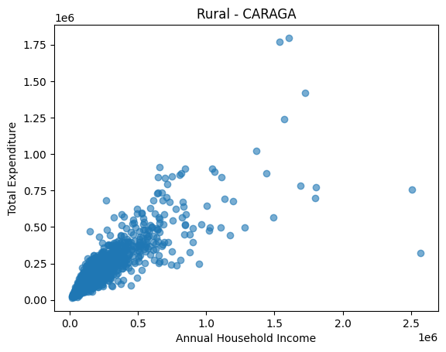
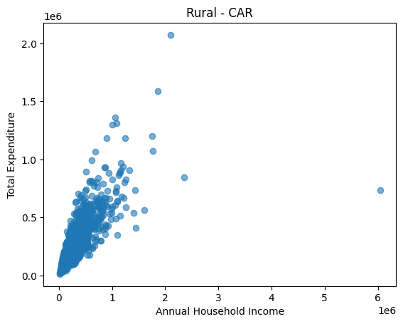
1. Urban vs. Rural Differences (Other Regions)
VII Central Visayas (Urban) vs CARAGA (Rural)
Urban Central Visayas: More consumption‑driven at the bottom, but higher brackets save progressively more.
Rural Caraga: Low-income households overspend slightly, but middle and upper brackets are consistently restrained, with much larger savings margins.
Savings potential: CARAGA households (especially upper brackets) save more relative to income compared to their Central Visayas counterparts.
Correlation slope: Urban households shows a stronger positive correlation between income and expenditure, while Rural households shows a flatter correlation — spending grows slower relative to income.
XI Davao Region (Urban) vs CAR (Rural)
CAR is richer than Davao Region in terms of reported household income at the top bracket.
However, Davao’s rich spend more in absolute terms (₱1.42M vs ₱737k), reflecting stronger consumption intensity.
CAR’s wealthy households appear to save or under‑consume relative to their income, while Davao’s wealthy households spend more visibly.
Correlation slope: Urban households shows a stronger positive correlation between income and expenditure, while Rural households shows a weaker, flatter correlation — especially at the top.

Slide 8
Overall Insights:
How do household incomes and expenditures differ between urban and rural households?
Urban Regions
Pattern: More consumption‑driven. Low-income households overspend or break even; middle brackets balance; rich households save but still spend heavily in absolute terms.
Correlation: Strong positive correlation between income and expenditure. The slope is steeper — expenditure rises quickly with income, especially at lower brackets, then flattens at the top as savings grow.
Rural Regions
Pattern: More restrained. Low-income households sometimes overspend, but middle and upper brackets consistently spend less than income. Rich households spend a much smaller fraction of their income compared to urban counterparts.
Correlation: Positive correlation but weaker/flatter slope. Expenditure grows more slowly relative to income, especially at higher brackets. Points cluster below the “income = expenditure” line, showing stronger savings margins.

Slide 9
Methodologies (Table):
Income Bracket |  | Annual Household Income | Total Expenditure
0 | Poor | 102868.52 | 132141.08
1 | Low Income | 198776.17 | 226004.41
2 | Lower Middle | 371226.56 | 372991.53
3 | Middle Income | 685871.06 | 637947.56
4 | Upper Middle | 1141796.34 | 969129.13
5 | Upper Middle not Rich | 2024821.18 | 1506951.32
6 | Rich | 3485836.88 | 2466226.76
#Urban - NCR (Average)
#Define bins and labels (based on 'Income Brackets’)
bins = [0, 132_000, 264_000, 528_000, 924_000, 1_572_000, 2_628_000,
float('inf')]
labels = ['Poor', 'Low Income', 'Lower Middle', 'Middle Income',
'Upper Middle', 'Upper Middle not Rich', 'Rich']
#Filter dataset for Region only
urban_df = df[df['Region'] == 'NCR']#<-direct equality filter
#Create Income Bracket column
urban_df['Income Bracket'] = pd.cut(urban_df['Annual Household Income'],
bins=bins, labels=labels)
#Group and calculate averages
summary_df = (
urban_df.groupby('Income Bracket')[['Annual Household Income', 'Total Expenditure']]#<-grouping (index) and [dataframe]
.mean()
.round(2)
.reset_index()#<-reorganizes dataframe after grouping/filtering data
)
summary_df

Slide 10
Methodologies (Graph):
#Urban - NCR
urban_df = df[df['Region'] == 'NCR']
#Scatter plot of raw values
#plt.scatter(x,y)
#x = Annual Household Income
#y = Total Expenditure
plt.scatter(urban_df['Annual Household Income'],
urban_df['Total Expenditure'],
alpha=0.6) #alpha makes overlapping points more visible (transparency setting)
plt.xlabel('Annual Household Income')
plt.ylabel('Total Expenditure')
plt.title('Urban - NCR')
plt.show()

Slide 11
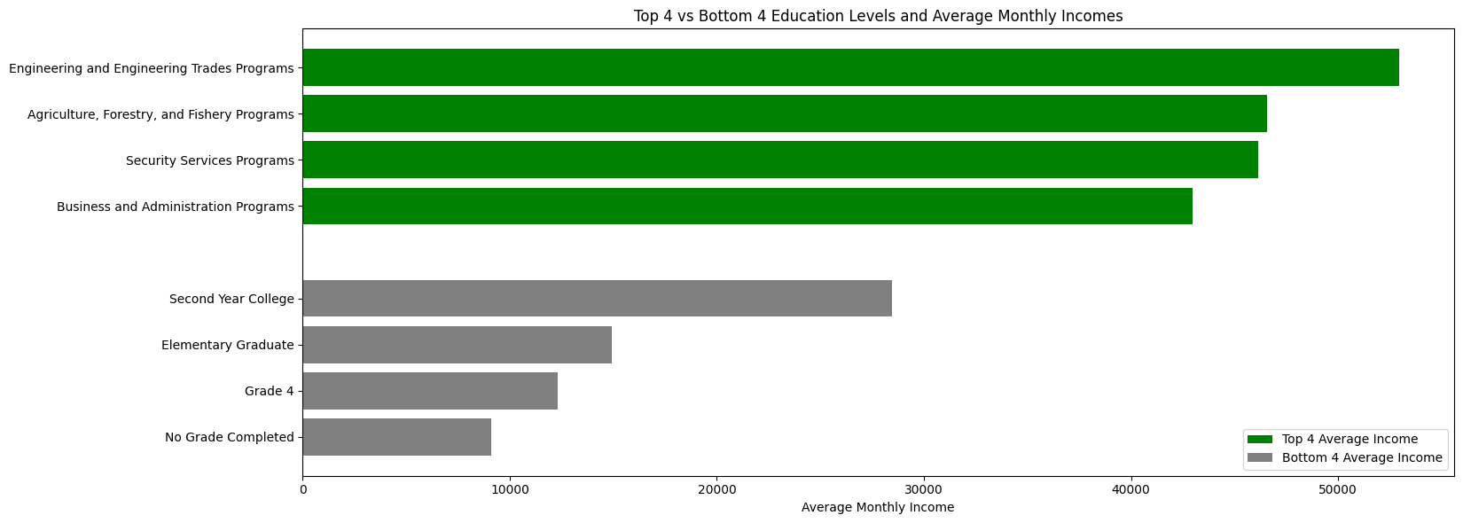
2. Impact of Education on Income

Slide 12
Insights:
Do household heads with higher education levels earn more?
Household heads with higher education levels tend to earn higher average monthly income.
Those with no grade completed or lower education levels earn significantly less.
Education is strongly linked to better income opportunities.

Slide 13
Methodologies (Graph):
#Top 5 Average Monthly Income
top5_high = df[['Household Head Highest Grade Completed', "Monthly Income"]].sort_values(by='Monthly Income', ascending=False) \
.head(5)
top5_high_mean_income = df[df['Household Head Highest Grade Completed'].isin(top5_high['Household Head Highest Grade Completed'])] \
.groupby('Household Head Highest Grade Completed')['Monthly Income'] \
.mean() \
.round(2)
#Bottom 5 Average Monthly Income
bottom5 = df[['Household Head Highest Grade Completed', "Monthly Income"]].sort_values(by='Monthly Income', ascending=False) \
.tail(5)
bottom5_low_mean_income = df[df['Household Head Highest Grade Completed'].isin(bottom5['Household Head Highest Grade Completed'])] \
.groupby('Household Head Highest Grade Completed')['Monthly Income'] \
.mean() \
.round(2)
high = top5_high_mean_income.sort_values(ascending=False) # top 5 highest incomes
low = bottom5_low_mean_income.sort_values(ascending=False) # bottom 5 lowest incomes

Slide 14
Methodologies (Graph):
high = top5_high_mean_income.sort_values(ascending=False) # top 5 highest incomes
low = bottom5_low_mean_income.sort_values(ascending=False) # bottom 5 lowest incomes
#Combine labels (all unique grade levels from high and low)
labels = list(high.index) + list(low.index)
#Combine values
values_high = high.values
values_low = low.values
#Create figure
fig, ax = plt.subplots(figsize=(16.6,6))
#Horizontal positions for bars
y_high = np.arange(len(values_high))
y_low = np.arange(len(values_low)) + len(values_high) + 1 # add space between high and low groups
#Plot bars
ax.barh(y_high, values_high, color='green', label='Top 4 Average Income')
ax.barh(y_low, values_low, color='gray', label='Bottom 4 Average Income')

Slide 15
Methodologies (Graph):
#Set y-ticks and labels
ax.set_yticks(list(y_high) + list(y_low))
ax.set_yticklabels(list(high.index) + list(low.index))
#Labels and title
ax.set_xlabel('Average Monthly Income')
ax.set_title('Top 4 vs Bottom 4 Education Levels and Average Monthly Incomes')
#Invert y axis
ax.invert_yaxis()
#Legend
ax.legend()
#Layout
plt.tight_layout()
plt.show()

Slide 16
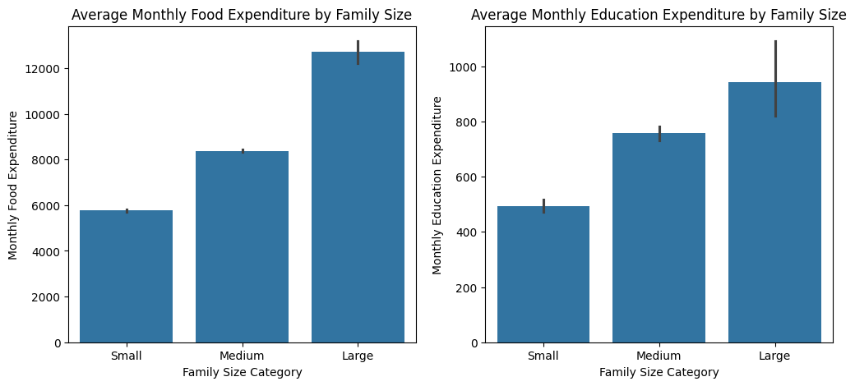
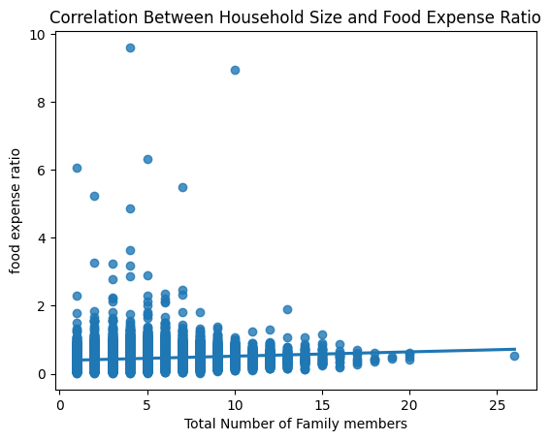
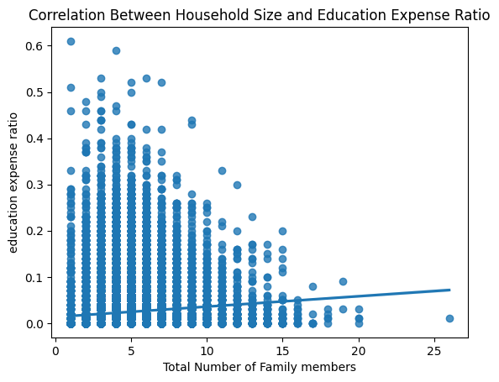
3. Household Size and Spending
Do larger families spend more on food or education?
Insights: (Bar Graph)
Large families tend to spend more on both food and education compared to small and medium families, because more household members require additional resources such as meals and educational support.
While education spending also rises with family size, the increase is relatively moderate compared to food spending, indicating that education expenses may depend on the number of school-aged members rather than total household size.
Insights: (Regression plot)
Ratios are used to reduce the bias caused by differences in household income levels.
The proportion of income allocated to food and education expenses does not increase significantly as family size grows. In general, the correlation is weak.
Large family spends more money overall but the percentage of income spent does not increase as much due to the fact that expenses can be shared among household members.

Slide 17
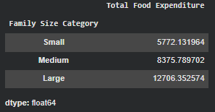
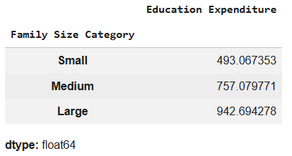
Methodologies (Modifying & Column Creation):
#categorizing family size into small, medium, large. Category was based on Researchgate.com literature.
df['Family Size Category'] = pd.cut(df['Total Number of Family members'], bins= [0, 4, 10, 30],labels = ['Small', 'Medium', 'Large']) # It's for Numerical Values Only
(df.groupby('Family Size Category')['Total Food Expenditure'].mean())/12
(df.groupby('Family Size Category')['Education Expenditure'].mean())/12

Slide 18
Methodologies (Bar Graph):
# Provide Filter for food and education expense for monthly basis
filt_food = df['Total Food Expenditure']/12
filt_edu = df['Education Expenditure']/12
#Subplot is used to display multiple graph in one figure
fig, axes = plt.subplots(1,2, figsize=(12,5)) #parameters inside subplot were the row(1) and column (2).
#Uses Seaborn lib to plot
sns.barplot(data=df, x='Family Size Category', y= filt_food, ax=axes[0])
axes[0].set_ylabel('Monthly Food Expenditure')
axes[0].set_xlabel('Family Size Category')
axes[0].set_title('Average Monthly Food Expenditure by Family Size')
sns.barplot(data=df, x='Family Size Category', y=filt_edu, ax=axes[1])
axes[1].set_ylabel('Monthly Education Expenditure')
axes[1].set_xlabel('Family Size Category')
axes[1].set_title('Average Monthly Education Expenditure by Family Size')
plt.show()

Slide 19
Methodologies (Scatter Plot):
# Created new column for expense ratio.
df['food expense ratio'] = ((df['Total Food Expenditure']/12)/(df['Monthly Income'])).round(2)
df['education expense ratio'] = ((df['Education Expenditure']/12)/(df['Monthly Income'])).round(2)
# Visualizing data using regression plot
sns.regplot(
data=df,
x='Total Number of Family members',
y='food expense ratio'
)
plt.title("Correlation Between Household Size and Food Expense Ratio")
plt.show()
sns.regplot(
data=df,
x='Total Number of Family members',
y='education expense ratio'
)
plt.title("Correlation Between Household Size and Education Expense Ratio")
plt.show()

Slide 20
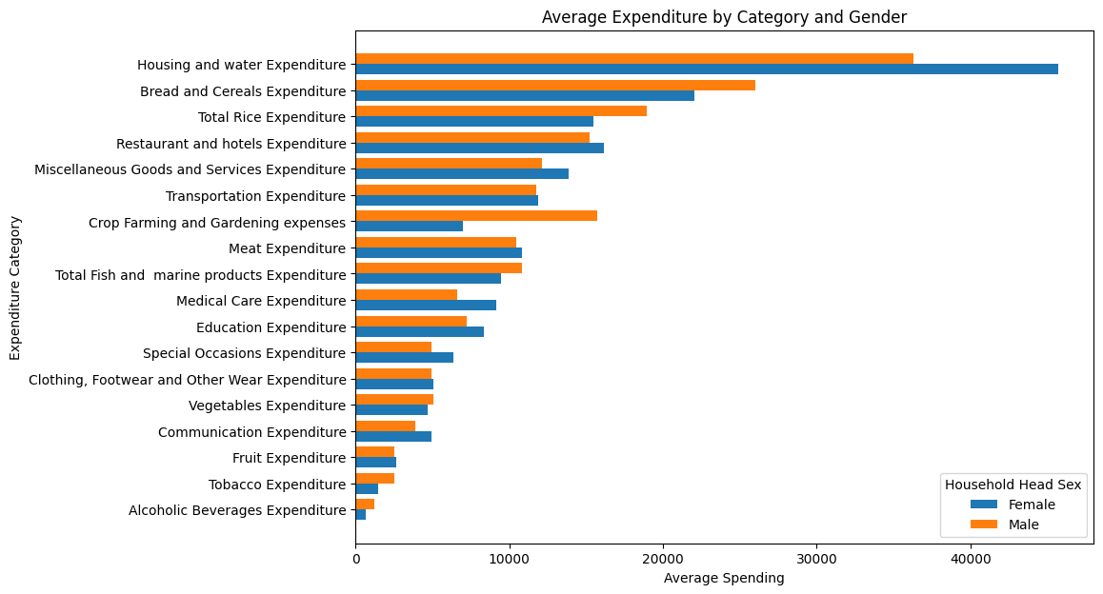
4. Gender Differences in Household Economics (Countrywide)
Is there a difference in spending patterns based on the sex of the household head?
Insights:
Female-headed households spend more on household and family need categories such as Housing and Water, Medical Care, Education, Special Occasions, and Communication expenditures.
Male-headed households allocate more spending toward staple foods and agriculture expenses, such as rice, bread and cereals, and crop farming and gardening, along with higher spending on tobacco and alcoholic beverages, indicating greater focus on agricultural activities and personal consumption.
Overall, both groups prioritize core necessities like housing and staple foods, but there is a slight difference in spending patterns between household welfare and agricultural or personal expenses.

Slide 21
Methodologies (Graph):
# Defines all expenses within a household
exp_cols = [
'Bread and Cereals Expenditure','Total Rice Expenditure','Meat Expenditure','Total Fish and marine products Expenditure','Fruit Expenditure',
'Vegetables Expenditure','Restaurant and hotels Expenditure','Alcoholic Beverages Expenditure','Tobacco Expenditure','Clothing, Footwear and Other Wear Expenditure','Housing and water Expenditure','Medical Care Expenditure','Transportation Expenditure','Communication Expenditure',
'Education Expenditure','Miscellaneous Goods and Services Expenditure','Special Occasions Expenditure','Crop Farming and Gardening expenses']
# Groups data by household head sex and calculates mean spending.
# .T (transpose) flips rows and columns so expenditure categories become rows.
avg_exp = df.groupby('Household Head Sex')[exp_cols].mean().T
# Creates a temporary average across Male and Female for each category
avg_exp["Total"] = avg_exp.mean(axis=1)
# Sorts categories from smallest to largest total spending
avg_exp = avg_exp.sort_values("Total", ascending=True)
# Removes the temporary Total column after sorting
avg_exp = avg_exp.drop(columns="Total")

Slide 22
Methodologies (Graph):
plt.figure(figsize=(10,7))
# Turns category into values on y axis used later on to avoid overlap
y = range(len(avg_exp))
# Creates female bar
plt.barh(y, avg_exp['Female'], height=0.4, label='Female')
# Shifts Male bars slightly so the two bars do not overlap
plt.barh([i+0.4 for i in y], avg_exp['Male'], height=0.4, label='Male')
# Places category in between the male and female bar
plt.yticks([i+0.2 for i in y], avg_exp.index)
plt.xlabel("Average Spending")
plt.ylabel("Expenditure Category")
plt.title("Average Expenditure by Category and Gender")
plt.legend(title="Household Head Sex")
plt.show()

Slide 23
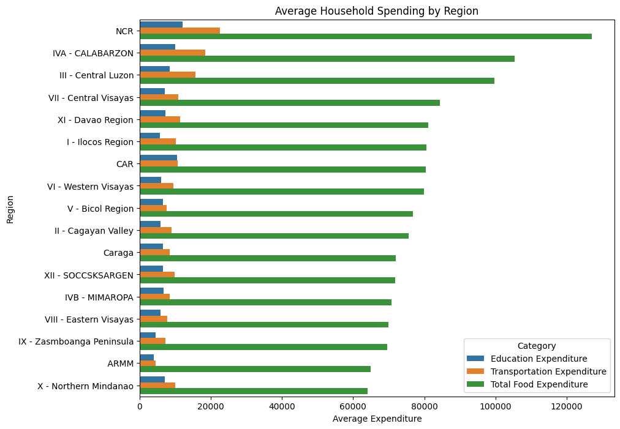
5. Regional Spending Patterns
Which regions spend the most on education, transportation, and food?
Insights:
Household spending is highest in urban regions like NCR, mostly on food, and lowest in rural areas like ARMM and Northern Mindanao.

Slide 24
Methodologies (Graph):
regional_spending = df.groupby('Region')[
['Education Expenditure', 'Transportation Expenditure', 'Total Food Expenditure']
].mean().reset_index()
regional_spending = regional_spending.sort_values('Total Food Expenditure', ascending=False)
df_regional_spending = regional_spending.melt(id_vars='Region', var_name='Category', value_name='Expenditure')
plt.figure(figsize=(10,8))
sns.barplot(data=df_regional_spending, x='Expenditure', y='Region', hue='Category')
plt.title('Average Household Spending by Region')
plt.xlabel('Average Expenditure')
plt.ylabel('Region')
plt.legend(title='Category')
plt.show()

Slide 25
6. Personal Exploration
“Impact of Lifestyle on Household Cost of Living”
Events - Special Occasions Expenditure (by JB)
Vehicles - Number of Car, Jeep, Van (by Matt)
Home Ownership - Tenure Status (by John)
Fashion - Clothing, Footwear and Other Wear Expenditure (by James)
Vices - Tobacco + Alcoholic Beverages Expenditure (by Euie)

Slide 26
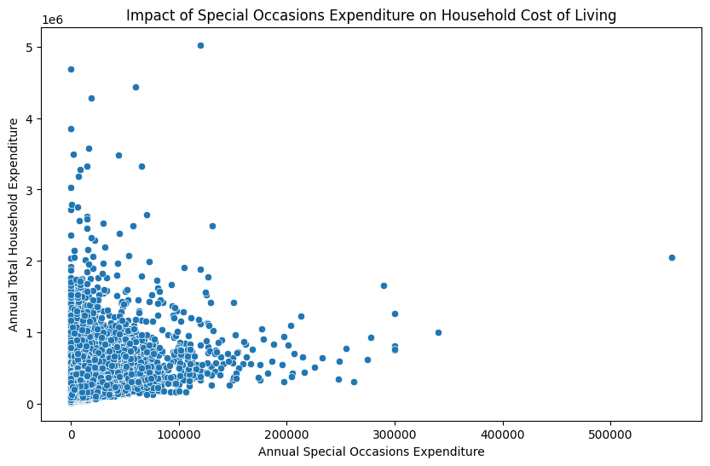
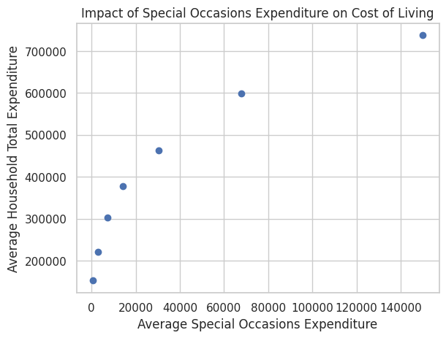
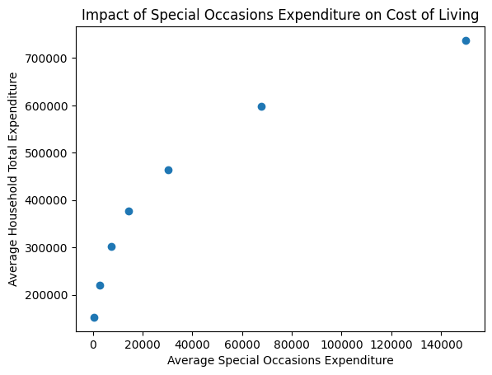
6.a. Impact of Lifestyle on Household Cost of Living: Special Occasions Expenditure
Insights:
Most households spend very little on special occasions, with spending highly concentrated near zero. The relationship with cost of living is weak, varies widely across households, and includes some outliers.

Slide 27
Methodologies (Graph):
plt.figure(figsize=(10,6))
sns.scatterplot(
data=df,
x='Special Occasions Expenditure',
y='Total Expenditure',
)
plt.title('Impact of Special Occasions Expenditure on Household Cost of Living')
plt.xlabel('Annual Special Occasions Expenditure')
plt.ylabel('Annual Total Household Expenditure')
plt.show()

Slide 28
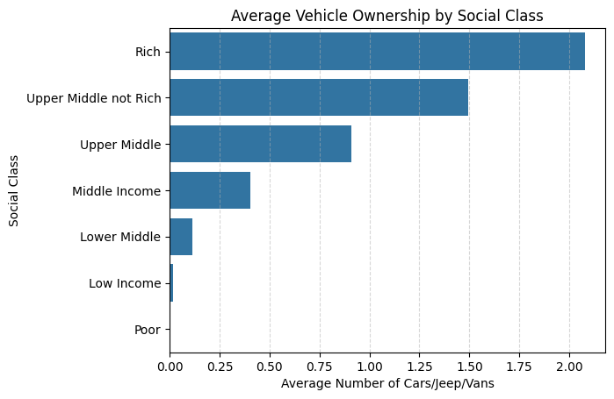
6.b. Impact of Lifestyle on Household Cost of Living: Number of Car, Jeep, Van
Insights:
Vehicle ownership increases significantly as households move into higher social class bands.
Poor and low-income households rarely own vehicles, while middle-income households begin to show moderate vehicle ownership (around 0.5 vehicles on average).
Upper-middle households average about 0.9 vehicles, while upper-middle (not rich) households average roughly 1.5 vehicles, indicating that vehicle ownership becomes more common as income levels rise.
Rich households have the highest vehicle ownership, averaging about 2 vehicles per household, suggesting that vehicle ownership reflects lifestyle differences associated with higher income levels and increased cost of living.

Slide 29
Methodologies (Graph):
# Define bins and labels (based on 'Income Brackets’)
bins = [0, 132000, 264000, 528000, 924000, 1572000, 2628000, 9999999999999]
labels = ['Poor','Low Income','Lower Middle','Middle Income','Upper Middle','Upper Middle not Rich','Rich']
# Creates Social Class Labels by Merging bins and label
df['Social Class'] = pd.cut(df['Total Household Income'], bins=bins, labels=labels)
# Calculates the average number of vehicles owned per social class
car_by_class = df.groupby('Social Class', observed=False)['Number of Car, Jeep, Van'].mean().reset_index()
# Sorts social classes by average vehicle ownership
car_by_class = car_by_class.sort_values('Number of Car, Jeep, Van', ascending=False)
# Creates the bar chart and forces seaborn to follow the sorted class order
sns.barplot(data=car_by_class,
y='Social Class',
x='Number of Car, Jeep, Van',
order=car_by_class['Social Class'])

Slide 30
Methodologies (Graph):
plt.title("Average Vehicle Ownership by Social Class")
plt.xlabel("Average Number of Cars/Jeep/Vans")
plt.ylabel("Social Class")
# Creates grid lines for readability
plt.grid(axis='x', linestyle='--', alpha=0.5)
plt.show()

Slide 31
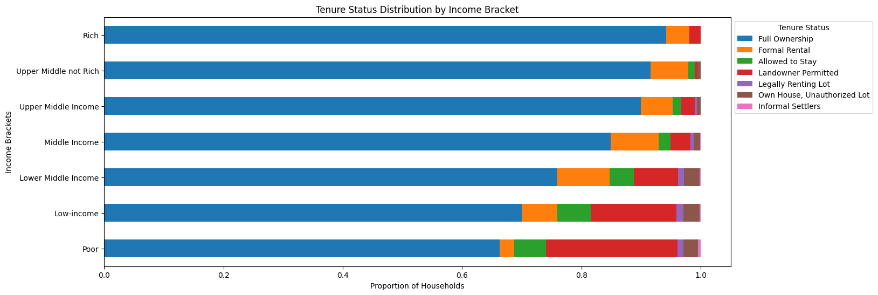
6.c. Impact of Lifestyle on Household Cost of Living: Tenure Status

Slide 32
6.c. Impact of Lifestyle on Household Cost of Living: Tenure Status
Insights
The distribution of tenure status across income brackets suggests that housing security improves with income.
Higher-income households are more likely to fully own their homes, while lower-income households exhibit a greater reliance on informal or less secure housing arrangements
Lower Middle to Middle Income may rent temporarily while building financial stability to own a house and lot.

Slide 33
Methodologies (Graph):
# cleaning N/A data
df =df[df['Tenure Status'] != 'Not Applicable']
tenure_map = {
'Own or owner-like possession of house and lot': 'Full Ownership',
'Rent-free house and lot with consent of owner': 'Allowed to Stay',
'Own house, rent-free lot with consent of owner': 'Landowner Permitted',
'Own house, rent lot': 'Legally Renting Lot',
'Rent house/room including lot': 'Formal Rental',
'Own house, rent-free lot without consent of owner': 'Own House, Unauthorized Lot',
'Rent-free house and lot without consent of owner': 'Informal Settlers'
}
df['Clear Tenure Status'] = df['Tenure Status'].map(tenure_map) # mapping the the certain categorical data inside a column to another/newly created column

Slide 34
Methodologies (Graph):
# Creating the variable for the proper order of the details in the graph.
income_order = [
'Poor',
'Low-income',
'Lower Middle Income',
'Middle Income',
'Upper Middle Income',
'Upper Middle not Rich',
'Rich'
]
legend_order = [
'Full Ownership',
'Formal Rental',
'Allowed to Stay',
'Landowner Permitted',
'Legally Renting Lot',
'Own House, Unauthorized Lot',
'Informal Settlers'
]

Slide 35
Methodologies (Graph):
#uses the pandas crosstab to create frequency table for 2 categorical data (row, column)
tenure_income = pd.crosstab(df['Income Brackets'], df['Clear Tenure Status'])
#get the sum of the each row (Inc brkt) then divide it for the freq of each column (clr tenure stat)
tenure_income = tenure_income.div(tenure_income.sum(axis=1), axis=0)
# It reorder the columns (clr tenure stat) of the table
tenure_income = tenure_income[legend_order]
#Sort rows to spec order, then plot stacked bar graph (hor)
tenure_income.loc[income_order].plot(kind='barh', stacked=True, figsize=(15,6))
plt.legend(title='Tenure Status',
bbox_to_anchor=(1, 1), # it allows to move the legend box outside
loc='upper left',
)
plt.title('Tenure Status Distribution by Income Bracket')
plt.ylabel('Income Brackets')
plt.xlabel('Proportion of Households')
plt.show()

Slide 36
6.d. Impact of Lifestyle on Household Cost of Living: Clothing, Footwear and Other Wear Expenditure
Insights:
Lower brackets: Clothing is a small but steady slice of both income and expenditure (~2%).
Middle brackets: Clothing peaks as a share of total expenditure (~2.5–2.6%), suggesting lifestyle consumption rises here.
Rich: Spend far more in absolute terms, but proportionally less of their income. Clothing becomes less significant relative to wealth.
Lower bracket households spend a consistent small share of income on clothing, while higher bracket households spend much more but proportionally less.
Income Brackets |  | Annual Household Income | Total Expenditure | Clothing, Footwear and Other Wear Expenditure
0 | Poor | 89464.54 | 105830.75 | 1889.48
1 | Low Income | 185194.68 | 193454.63 | 3659.91
2 | Lower Middle | 364847.08 | 335814.17 | 7586.78
3 | Middle Income | 671436.57 | 549882.44 | 13923.12
4 | Upper Middle | 1144448.28 | 822478.79 | 21739.25
5 | Upper Middle not Rich | 1960180.92 | 1189668.55 | 31298.32
6 | Rich | 4205280.00 | 1900359.46 | 43978.75

Slide 37
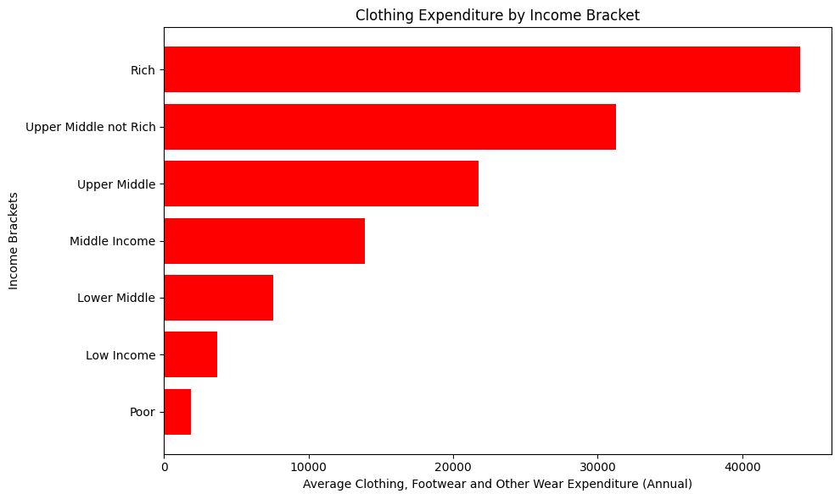
6.d. Impact of Lifestyle on Household Cost of Living: Clothing, Footwear and Other Wear Expenditure
Insights:
Lower brackets: Clothing is a small but steady slice of both income and expenditure (~2%).
Middle brackets: Clothing peaks as a share of total expenditure (~2.5–2.6%), suggesting lifestyle consumption rises here.
Rich: Spend far more in absolute terms, but proportionally less of their income. Clothing becomes less significant relative to wealth.
Lower bracket households spend a consistent small share of income on clothing, while higher bracket households spend much more but proportionally less.

Slide 38
Methodologies (Table):
bins = [0, 132_000, 264_000, 528_000, 924_000, 1_572_000, 2_628_000, float('inf')]
labels = ['Poor', 'Low Income', 'Lower Middle', 'Middle Income',
'Upper Middle', 'Upper Middle not Rich', 'Rich']
# Create Income Bracket column for the whole dataset
clothing_df = df.copy()
clothing_df['Income Brackets'] = pd.cut(clothing_df['Annual Household Income'], bins=bins, labels=labels)
# Group and calculate averages: income, total expenditure, clothing expenditure
summary_df = (
clothing_df.groupby('Income Brackets')[['Annual Household Income',
'Total Expenditure',
'Clothing, Footwear and Other Wear Expenditure']]
.mean()
.round(2)
.reset_index()
)
summary_df

Slide 39
Methodologies (Graph):
# Group by Income Bracket and calculate average clothing expenditure
clothing_summary = (
df.groupby('Income Brackets')['Clothing, Footwear and Other Wear Expenditure']
.mean()
.round(2)
.reset_index()
)
# Plot bar chart
plt.figure(figsize=(10,6))
plt.barh(clothing_summary['Income Brackets'],
clothing_summary['Clothing, Footwear and Other Wear Expenditure'],
color='red')
plt.xlabel('Average Clothing, Footwear and Other Wear Expenditure (Annual)')
plt.ylabel('Income Brackets')
plt.title('Clothing Expenditure by Income Bracket')
plt.tight_layout()
plt.show()

Slide 40
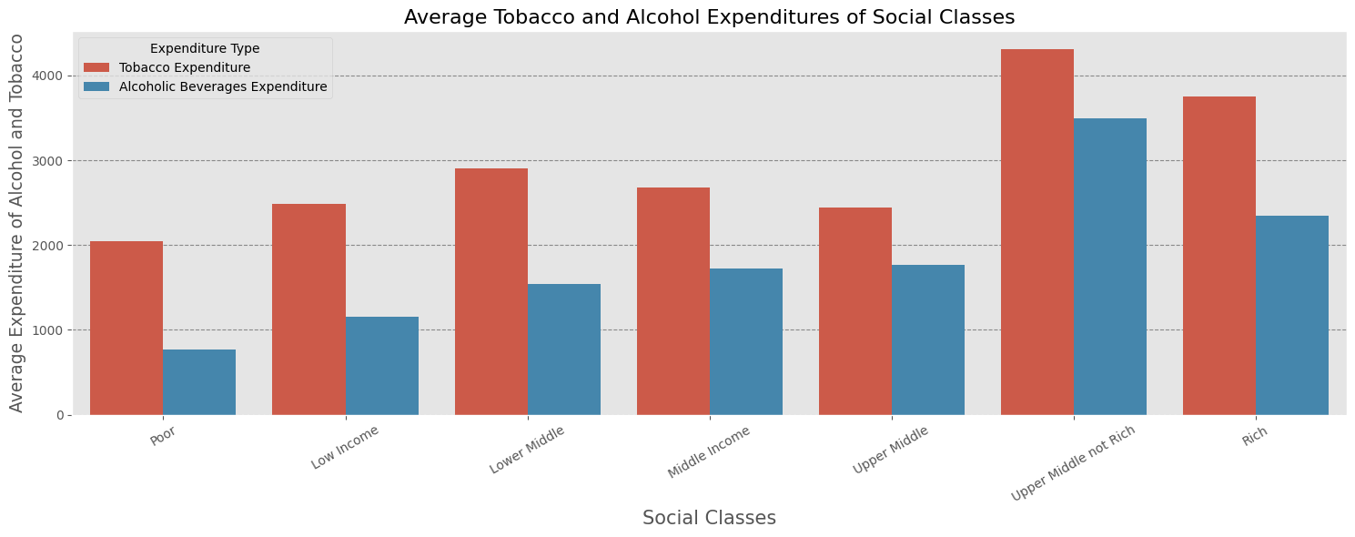
6.e. Impact of Lifestyle on Household Cost of Living: Tobacco + Alcoholic Beverages Expenditure

Slide 41
6.e. Impact of Lifestyle on Household Cost of Living: Tobacco + Alcoholic Beverages Expenditure
Tobacco & Alcohol Beverages Spending Insights
Income Bracket:
Upper-middle spend the most.
Poor spend the least.
Product Comparison:
Tobacco is purchased more frequently than alcohol.
Alcohol is less accessible to lower-income groups.
Factors Affecting Expenditure:
Sin Tax (RA 10351) raises prices.
Tobacco: Cheap, accessible, sold in singles.
Alcohol: Expensive, less accessible, sold in bottles.

Slide 42
Methodologies (Graph):
summary_df['Income Bracket'] = pd.Categorical(
summary_df['Income Bracket'],
categories=labels,
ordered=True
)
summary_df = summary_df.sort_values('Income Bracket')
plot_df = summary_df.melt(
id_vars='Income Bracket',
value_vars=['Tobacco Expenditure', 'Alcoholic Beverages Expenditure'],
var_name='Expenditure Type',
value_name='Average Expenditure'
)
plt.figure(figsize=(15,6))

Slide 43
Methodologies (Graph):
sns.barplot(
data=plot_df,
x='Income Bracket',
y='Average Expenditure',
hue='Expenditure Type'
)
plt.title('Average Tobacco and Alcohol Expenditures of Social Classes', fontsize=16)
plt.xlabel('Social Classes', fontsize=15)
plt.ylabel('Average Expenditure of Alcohol and Tobacco', fontsize=13.5)
plt.xticks(rotation=30)
plt.grid(visible=True, axis='y', linestyle='--', color='black', alpha=(0.4))
plt.tight_layout()
plt.show()

Slide 44
End.

